Slide 1


1

Slide 2
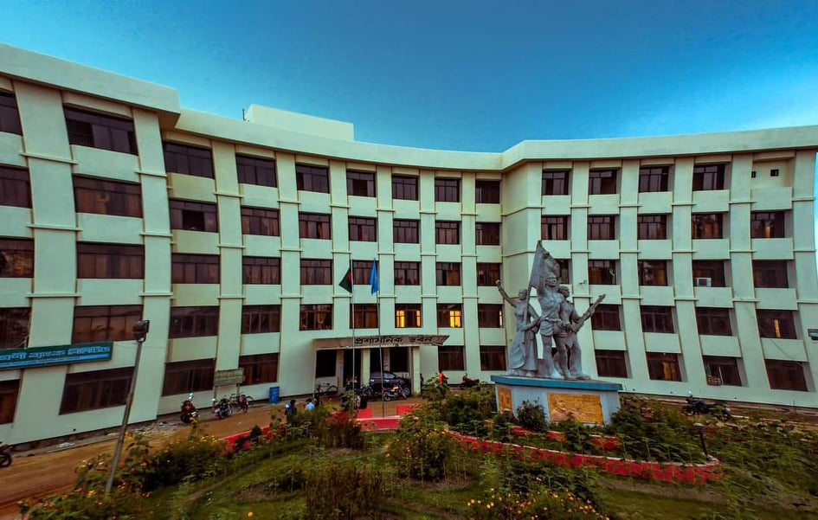
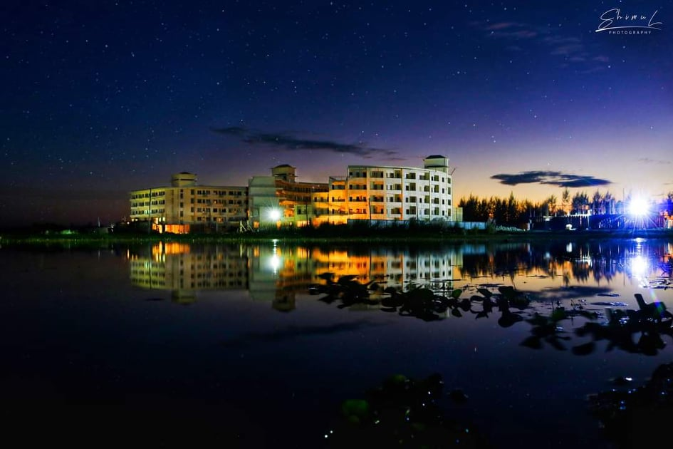
Active Student’s
Active Teacher’s
3000+
200+
Living Facilities
No Living Facilities
75-80%
20-25%
2

Slide 3

3

Slide 4
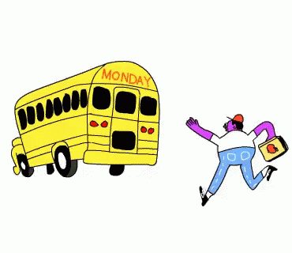
4

Slide 5
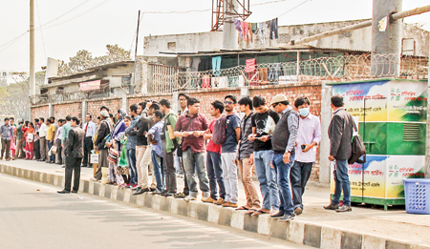
5

Slide 6
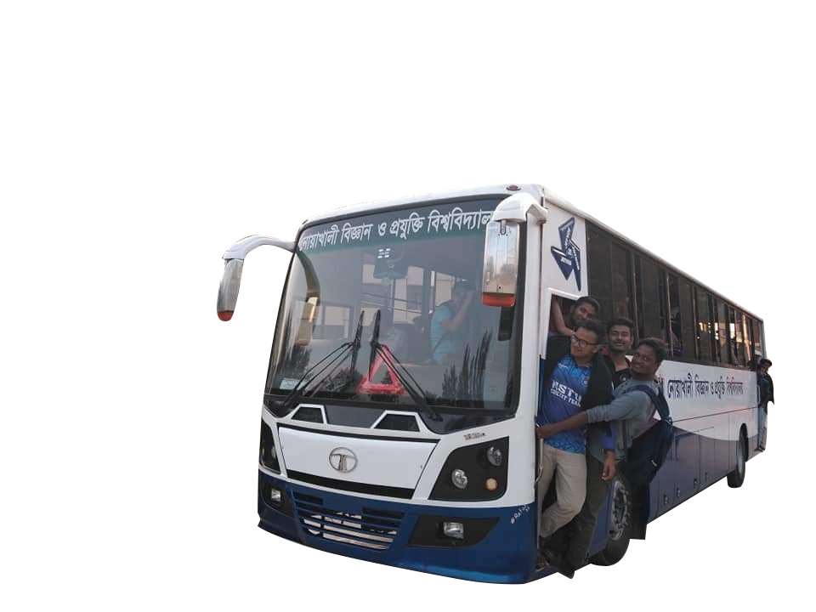

6

Slide 7
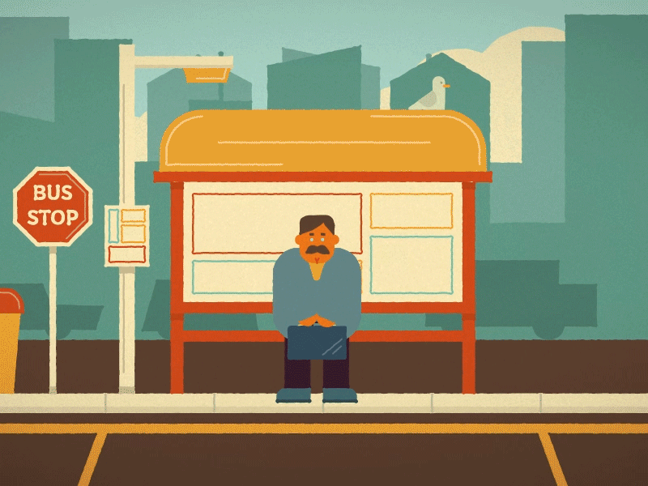
7

Slide 8
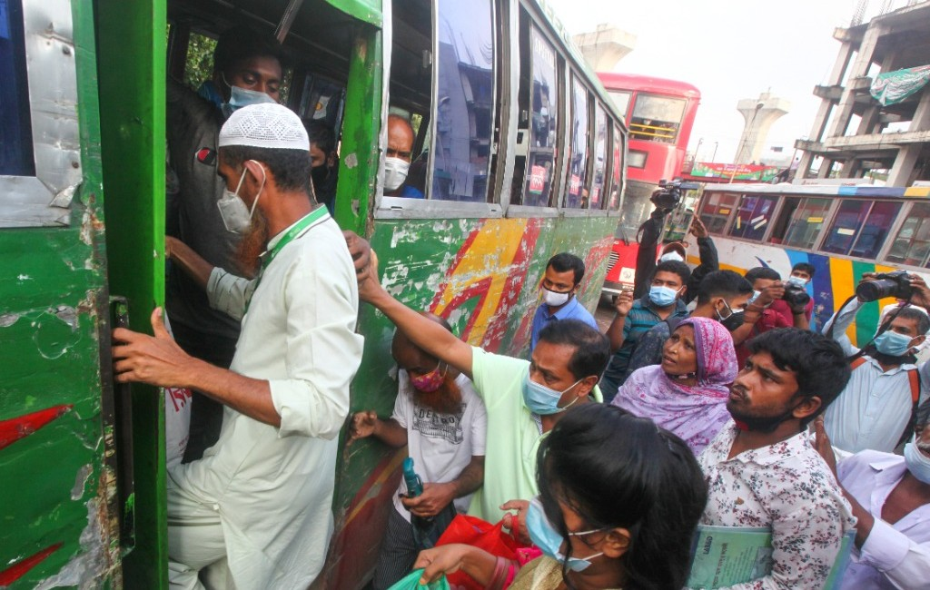
Extra Money
Sometimes Not Found any local transport
Not Reached at time
Physical Harassment
8

Slide 9
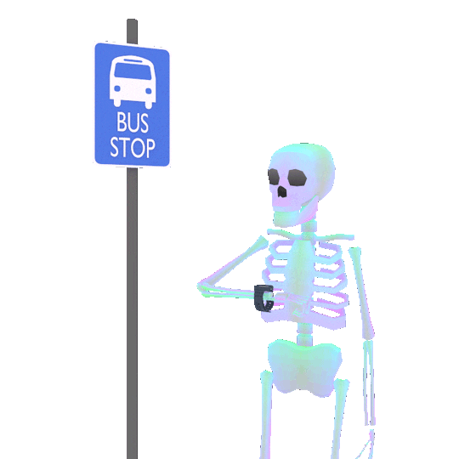

“NSTU
Bus Tracking System”

Slide 10
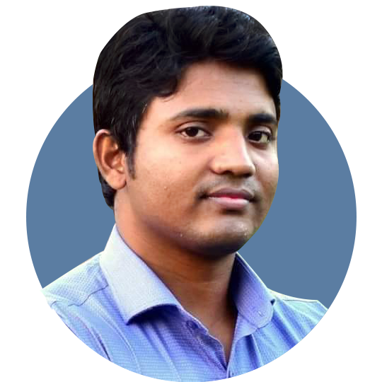
HOME
Supervisor
Auhidur Rahman Sumon
MARTIN PETER
Assistant Professor & Director(Acting)
IIT-NSTU
10

Slide 11


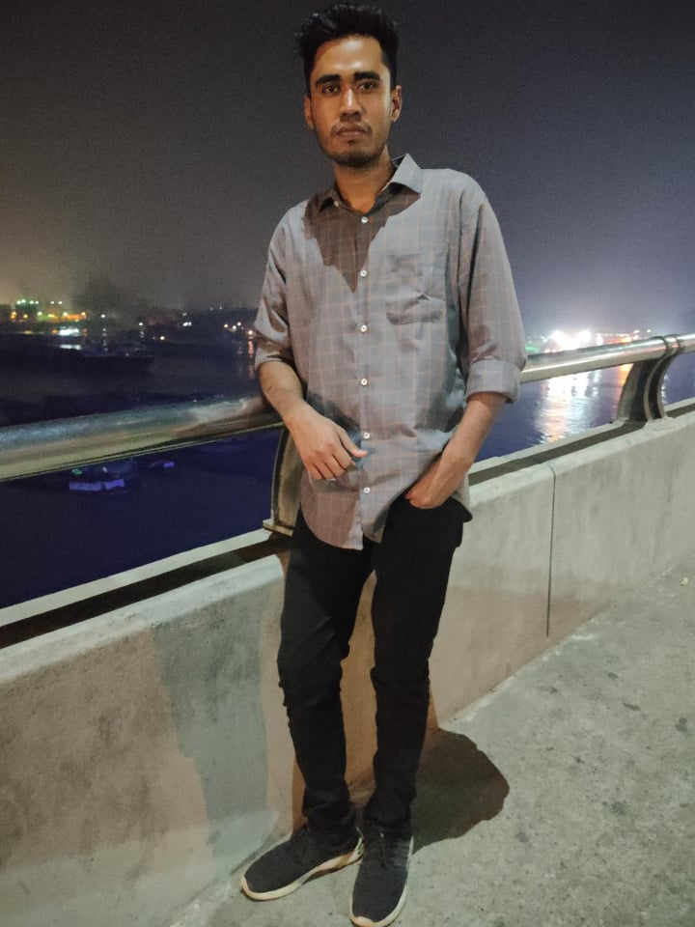

Meet the Team
Md AL ADNAN
Moon moon das
Md.Faisal ahammed
MUH1825008M
BKH1825027F
ASH1825015M
@aladnansami
@moonmoondas
@faisalahammed
Notes:
© Copyright Showeet.com – Creative & Free PowerPoint Templates

Slide 12

Objectives
To build a system which will track the current position and direction of the bus and show it to the user who wants to travel by the bus.
To give the proper and accurate information about the bus to the user.
To reduce the waiting time for travelling.
To ensure the necessary security of information and other processes.
12

Slide 13
Required Tools for Software Design
Technology used
Database Tools
01
Android Operating System 2.3 ("Gingerbread") or higher
Firebase
04
02
IDE Tools
Compatible Operating System
05
Android Studio
Windows, MAC, Linux, OS,Android
03
Back-End
Front-End
06
Java,javascript
Java xml
13

Slide 14
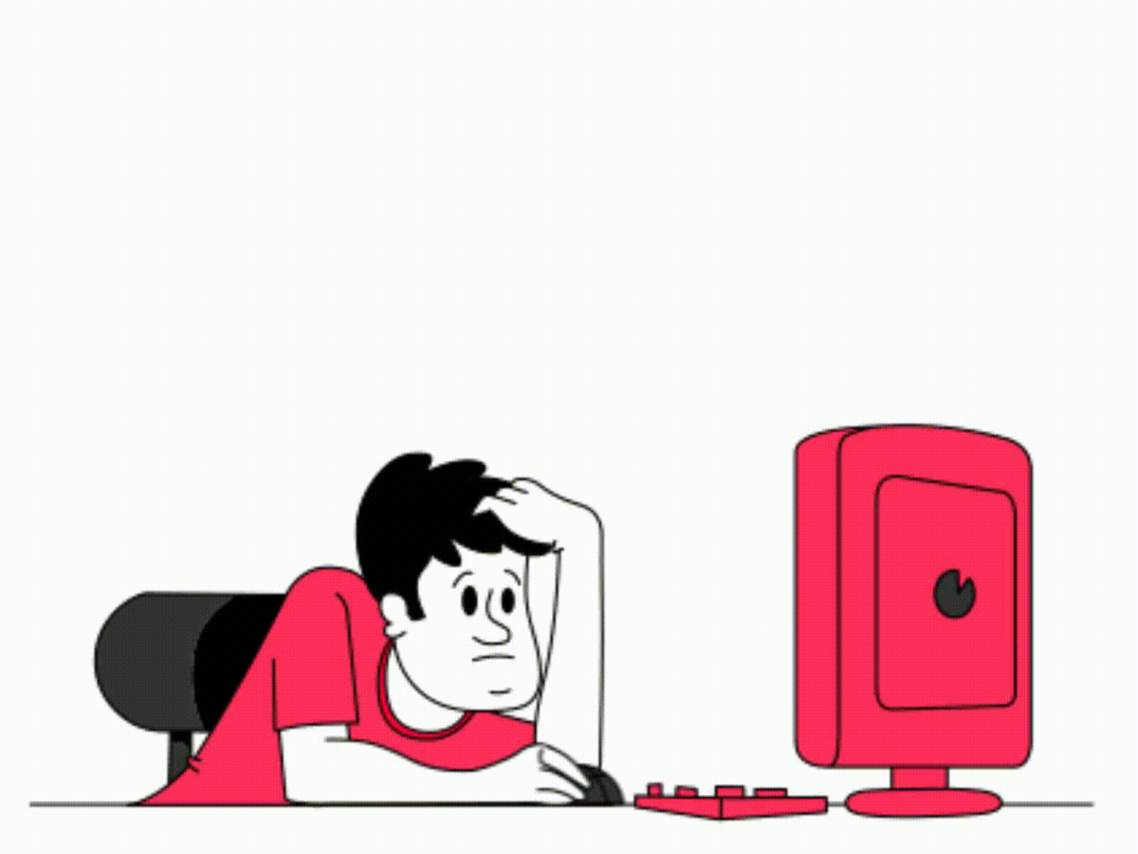
Hardware Requirement
01
Mobile Processor
02
Hard-Drive
1GHZ or higher
10gb And More
03
System Processor
Dual core and above
14

Slide 15


Functional Requirement
Allow user to retrieve information from mobile device
Show the currently available bus location in a map
Show information to user in real time
Administrator manage all the user
Save real time location records of bus when driver start ride
Verify the user with institutional email
Save real time location of currently logged in users
Emergency contact with administrator
15

Slide 16
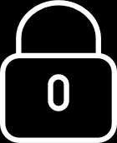
Non- Functional Requirement
Performance Requirement
Dependability Requirements
Security Requirements
Showing the bus position in a map view must be faster.
Showing the bus position in a map view must be accurate.
The system will handle thousands of data .
The system must be available on time.
The system handles all user access without system errors .
Signing in with an educational email in a student/teacher module .
Email verification.
Get access according to logged in user.
Signing out as a student/teacher.

Slide 17
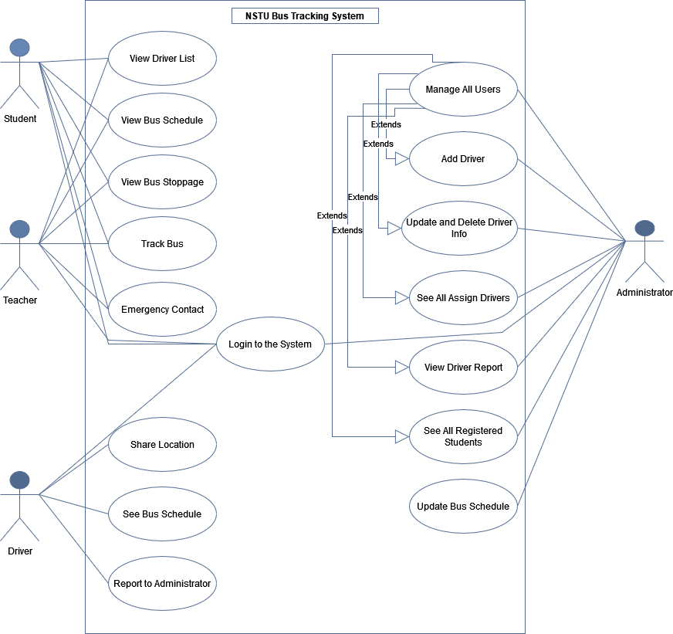
‘System Design’
1.Use Case Diagram

Slide 18
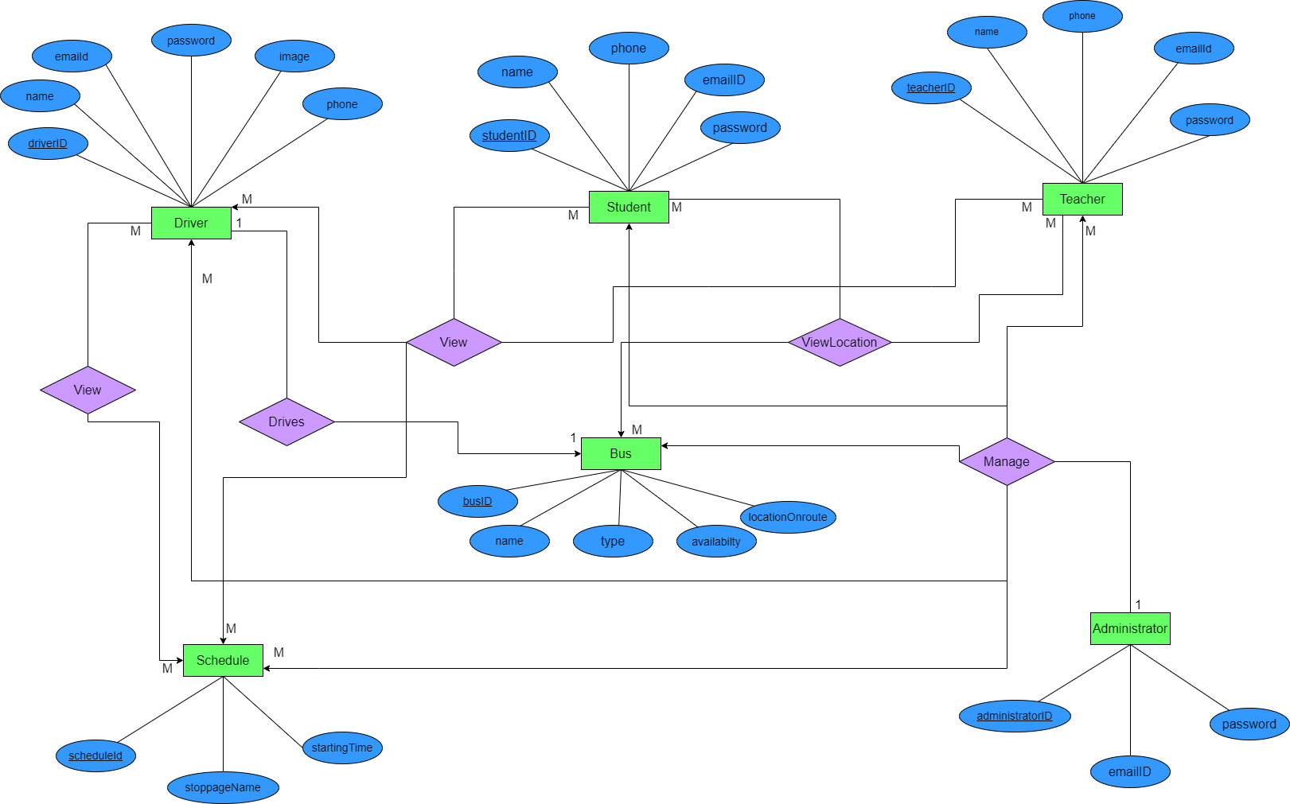
‘System Design’
2.E-R Diagram

Slide 19
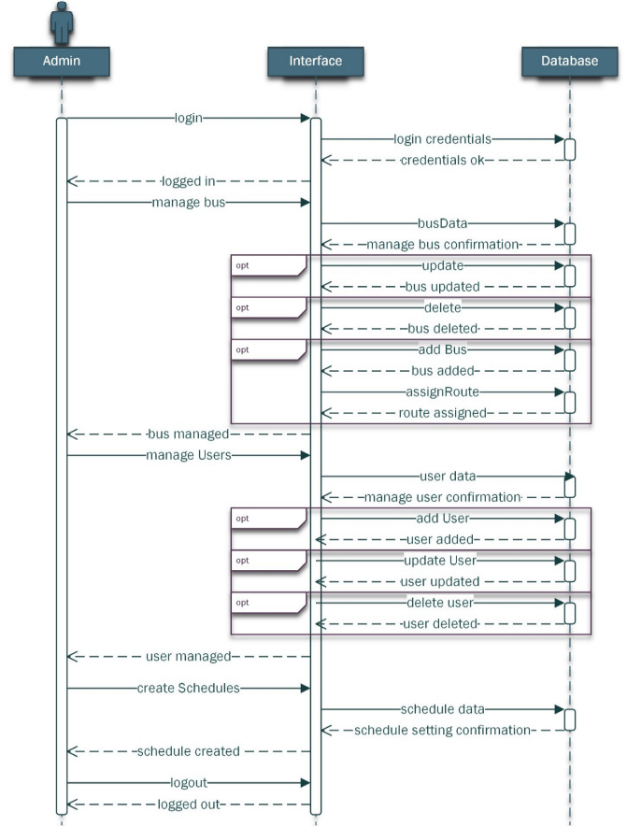
‘System Design’
3.Sequence Diagram

Slide 20
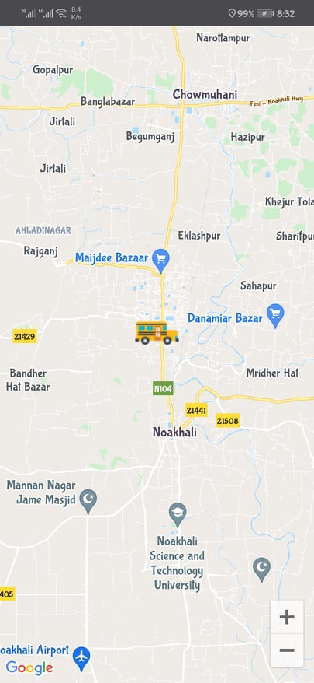
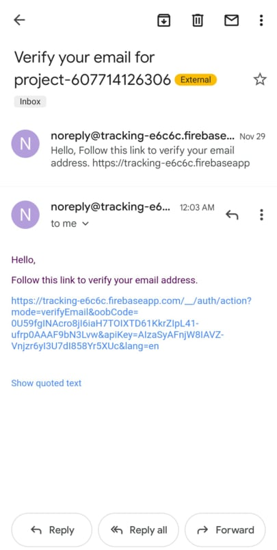
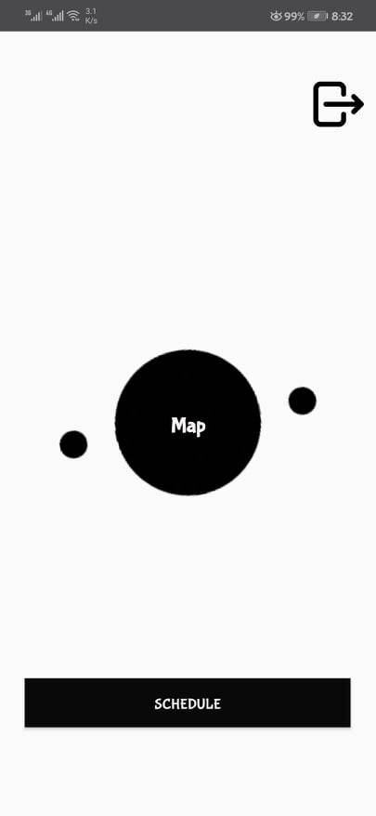
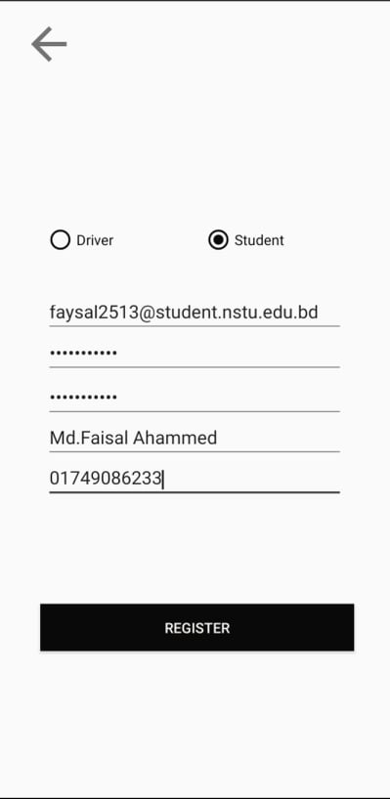
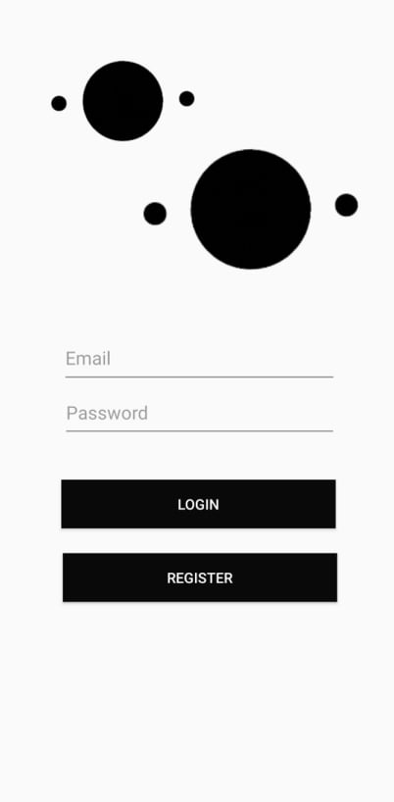
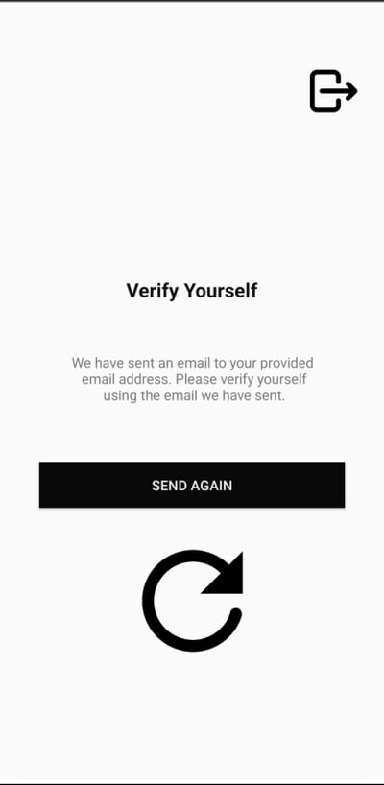
‘User Manual’
(Student & Teacher)Perspective

Slide 21
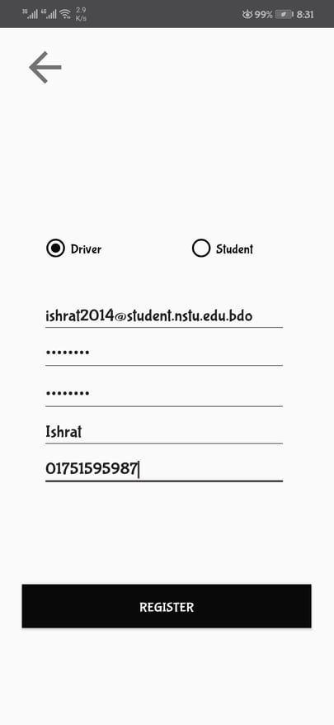
‘User Manual’
(Bus Driver)Perspective

Slide 22
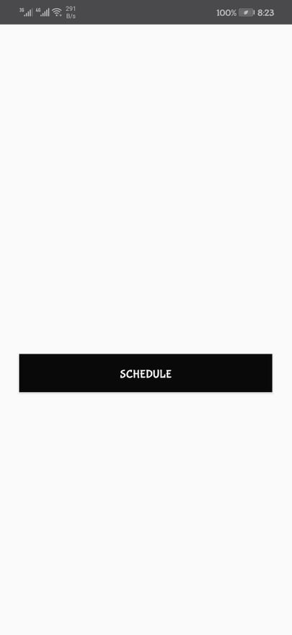
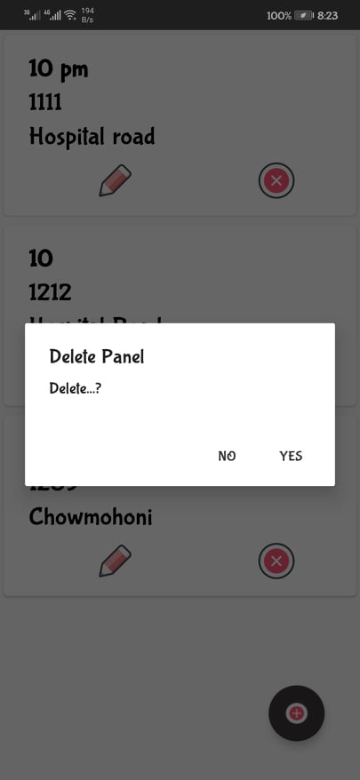
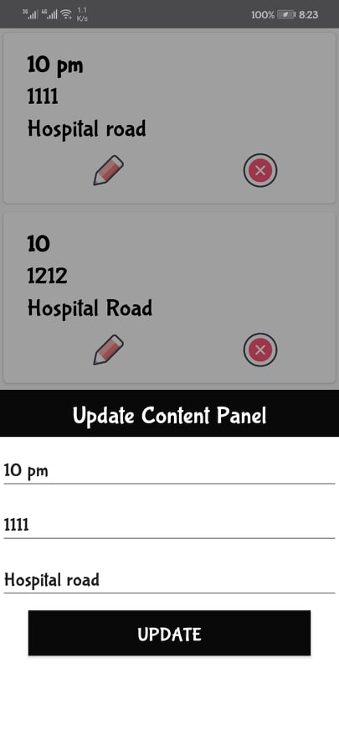
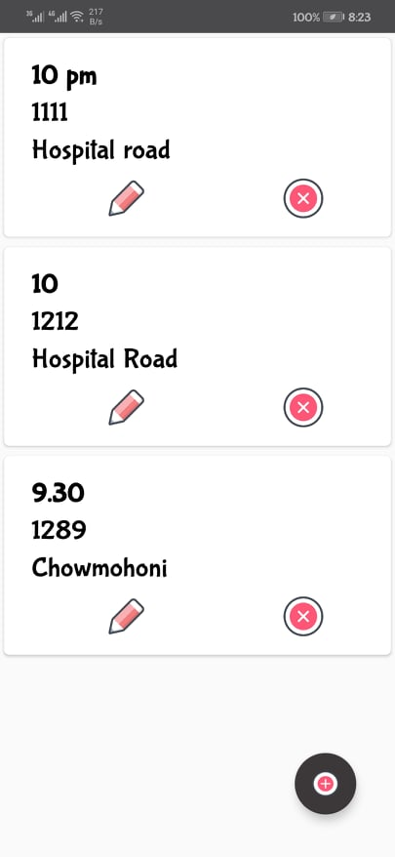
‘User Manual’
(Admin)Perspective

Slide 23

Future Plan
Enhanced and Rich UI will be Designed.
We will add more features to improve our project.
2021
Implement Emergency Contact.
2021
2022
Calculate arrival time and bus distance.
In the future, we will implement a seat allocation system.
2022
23

Slide 24
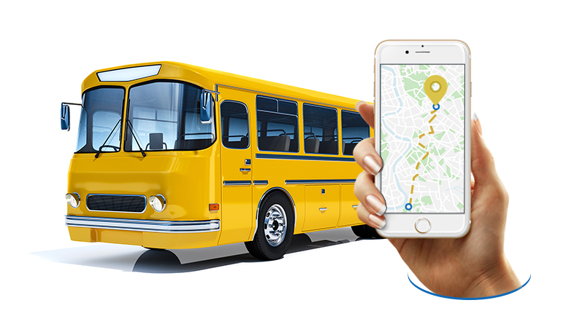
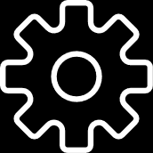
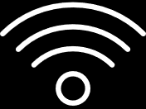
Software Design(Deliverables)
User Manual
SRS
Apps Apk
Apps Source File

Slide 25
